Slide 1

Threading by example
Presented by
Shereef Sakr

Slide 2
Agenda
Introduction
Challenges in threaded applications
Synchronization & Locks
Thread Pools
Session Objective engine
Introduction to Oracle Advanced Queues
General Guidelines

Slide 3
Session Objective
Develop an example engine
invokes URLs remotely
Dequeue URL from from a database queue
Invokes the remote URL
URLs exists in a database queue in an oracle database
Objective
Achieve 5 million requests/hour
Request time is 10 msec

Slide 4
Introduction
Why use threading
Increase performance
Keep the processor busy
Keep multiple processors busy

Slide 5
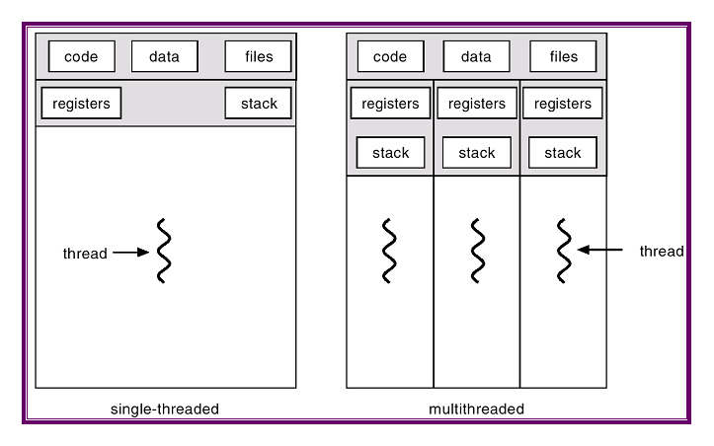
Sequential vs Parallel

Slide 6
Demo
Sample 01

Slide 7
Sample 01 Notes
Implement “Runnable” Interface
Create an instance from “Thread” class
Pass an instance of “Runnable” to “Thread” constructor
Don’t invoke “run”, invoke “start” method
Remember “Join”

Slide 8
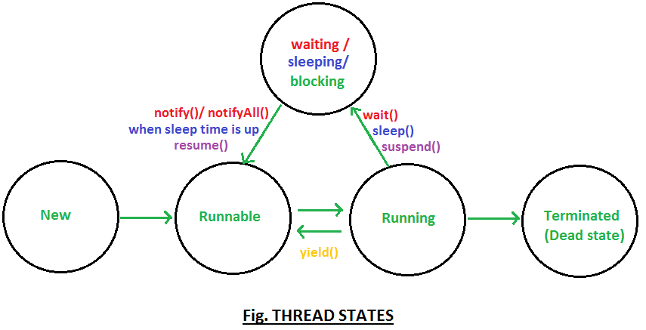
Thread States

Slide 9
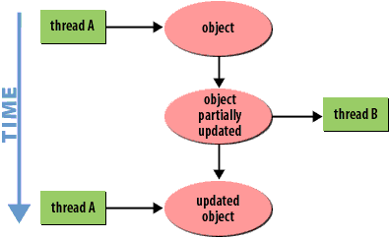
Threading Challenges

Slide 10
Threading Challenges (cont.)
Partially updated objects
Shared objects should be synchronized.
Or use Atomic Classes (AtomicInteger, …..)
Number of threads
Too low
Machine resources are not used efficiently
Throughput is low
Too high
CPU might take too much time switching between threads instead of doing actual execution.
Each thread execution time will be longer.
Throughput is low

Slide 11
Oracle Advanced Queues
Database data structure
Two Types
Single Consumer
Multiple Consumers

Slide 12
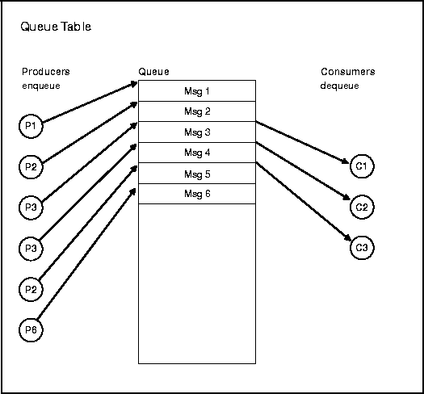
Oracle Advanced Queues (cont.)
Single Consumer

Slide 13
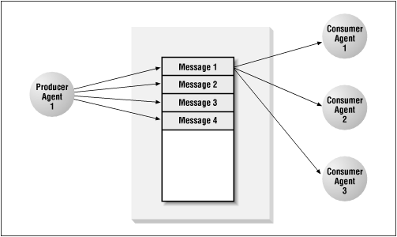
Oracle Advanced Queues (cont.)
Multiple Consumers

Slide 14
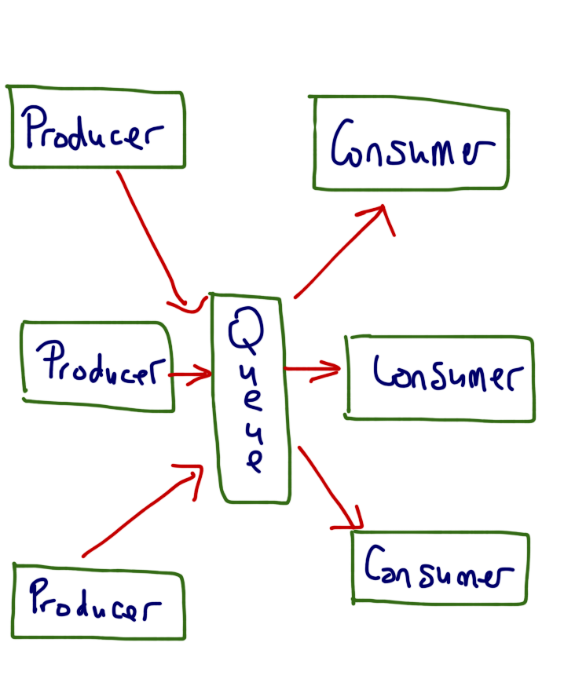
Producer Consumer Pattern

Slide 15
Java Blocking Queues
All inherit for Blocking Queue
Usually use ArrayBlockingQueue
Other Types
DelayQueue
PriorityBlockingQueue
Reference:
https://docs.oracle.com/javase/7/docs/api/java/util/concurrent/BlockingQueue.html

Slide 16
Thread Pools
Create an instance through Executors.new* method
Returns ExecutorService which is used to submit threads and control the thread pool
Usually we use FixedThreadPool
Other Types:
CachedThreadPool
ScheduledThreadPool
To run a thread periodically
SingleThread
WorkStealing
References:
https://docs.oracle.com/javase/tutorial/essential/concurrency/pools.html

Slide 17
General Guidelines
Logging
Log thread name in each line
Log4j properties, use %t in line pattern.
https://logging.apache.org/log4j/1.2/apidocs/org/apache/log4j/PatternLayout.html
Easy debugging and production support.
Log an identifier for each thread from business point of view.
For example, if threads handle SMSs, log mobile number in each line.
Log4j properties, use %X{KEY} in line pattern
http://wpcertification.blogspot.com.eg/2014/03/using-mdc-for-setting-context-variables.html
Make sure to put on start of thread and remove at end of thread code.
Easy debugging and production support.
Make sure to log the time (in milliseconds) for each I/O
File reading
Database Activity
Web Service Requests/ Http requests/…

Slide 18
General Guidelines (cont.)
Connection Pooling/Data source
Adjust Number of connections properly
If Number of threads > Number of connections
Some threads will be blocked, waiting for a connection to be available
If Number of threads < Number of connections
Some connections will not be used

Slide 19
General Guidelines (cont.)
Optimal number of threads vs processor cores
If threads only execute logic,
optimal number of threads = number of cores
Theoretical, never happens
Usually a thread is a mix between
logic execution (running state)
I/O (Waiting state)
File read/write
Network Calls (database statement or connection, web service, http request,…)

